Slide 1
经典考题(二) -- 数岛屿
200. Number of Islands
305. Number of Islands II
694. Number of Distinct Islands
711. Number of Distinct Islands II
463. Island Perimeter
695. Max Area of Island
934. Shortest Bridge
827. Making A Large Island
1254. Number of Closed Islands
1568. Minimum Number of Days to Disconnect Island
你们的好朋友Eddie

Slide 2
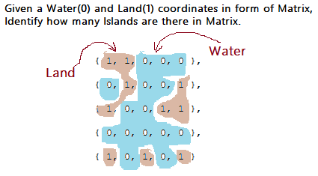
岛屿类题目考察知识点
DFS
BFS
Union Find
Path to describe shape
Tarjan’s Algorithm
Distributed processing as a follow up

Slide 3
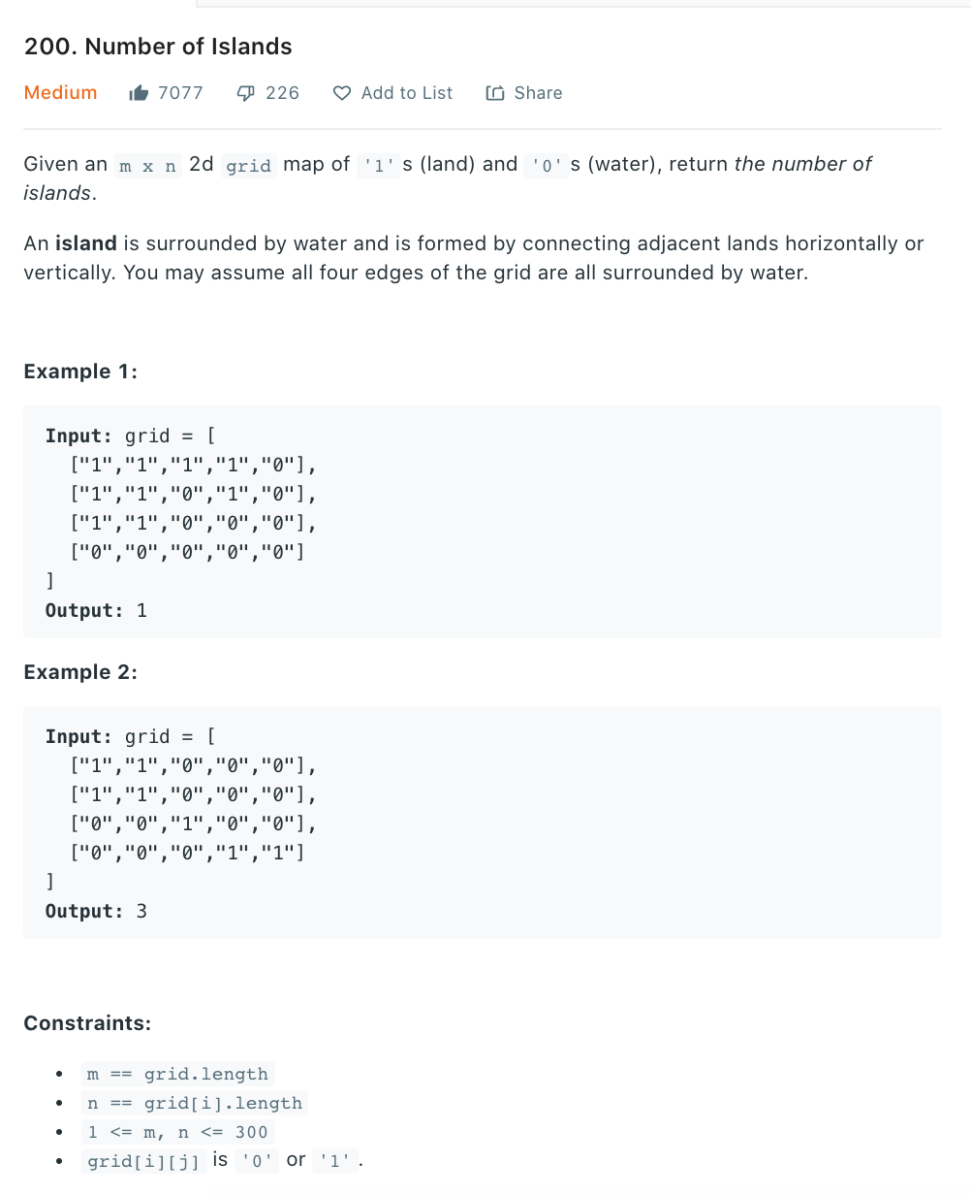
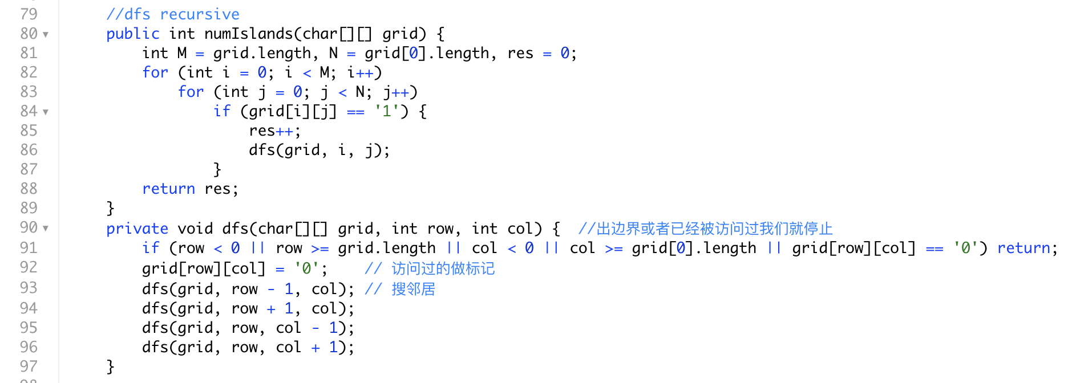
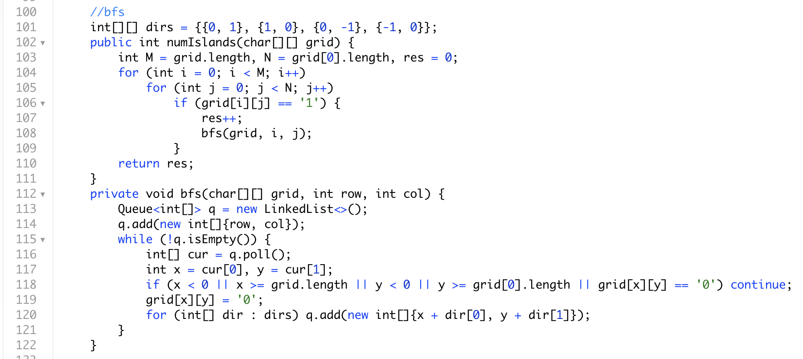
最最最基础，3种解法均可

Slide 4
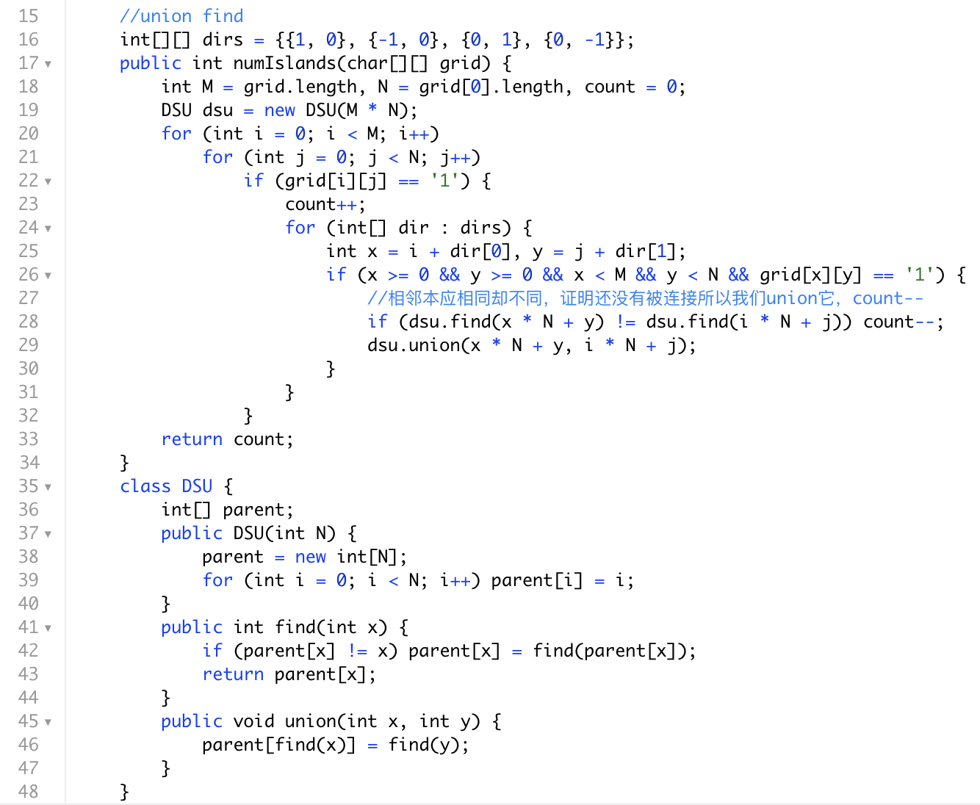
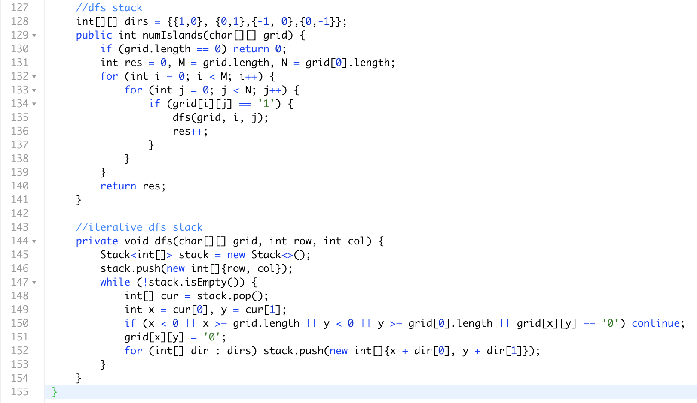
DFS iterative way, using extra space stack can work for big data
同样也可以用UF来做找关系，是否连接的题目，详细请查看union find专节
DFS空间复杂度？见附录分析之
Stack Memory and Heap Space in Java

Slide 5
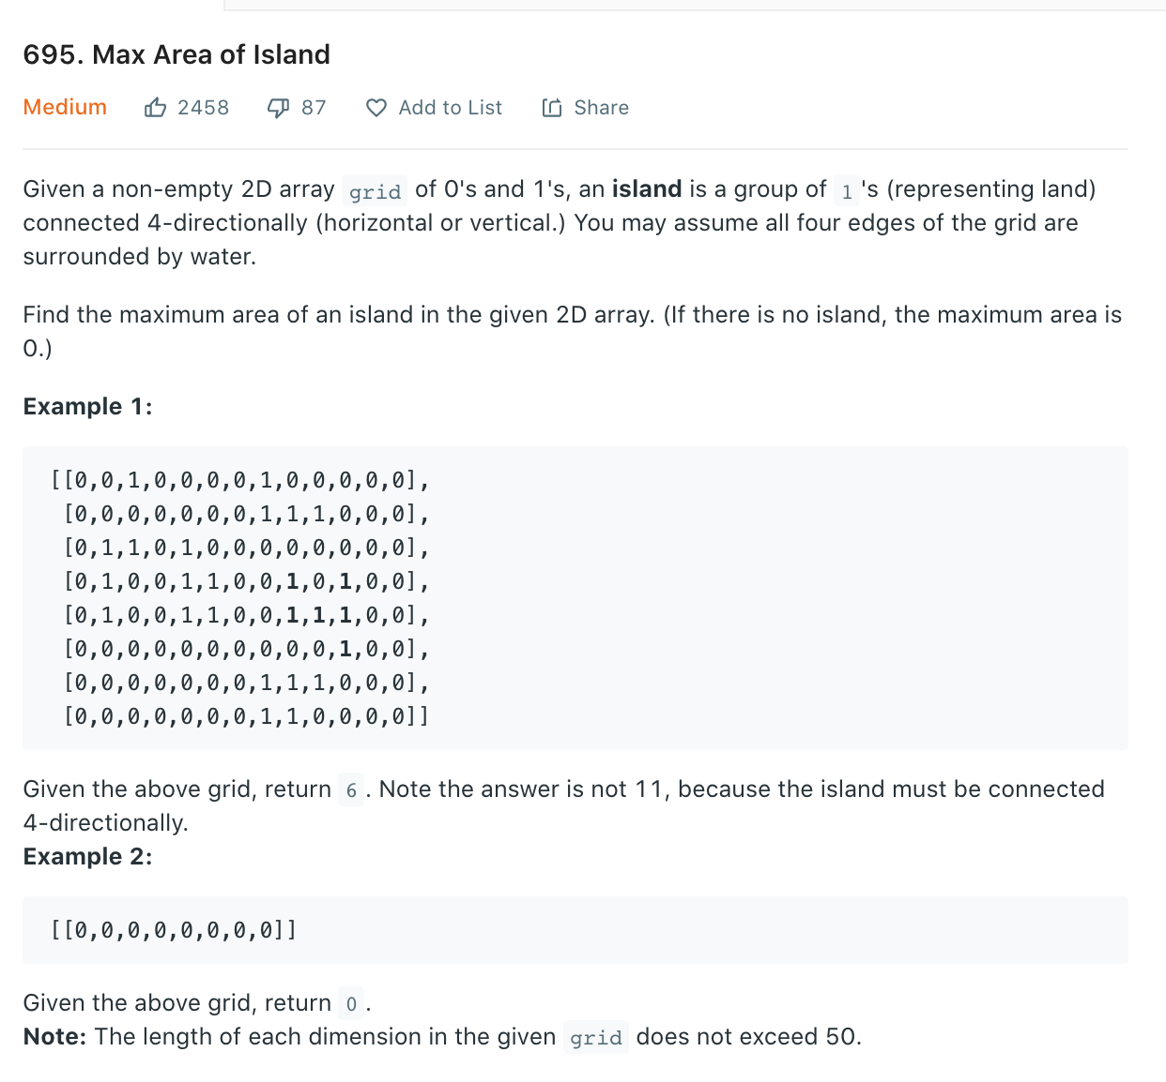
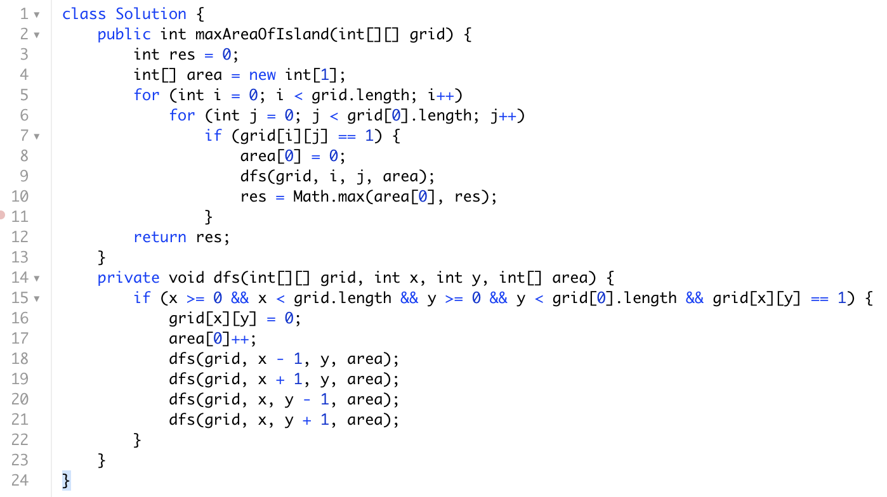
套娃题直接暴力，找哪一个group的1最多

Slide 6
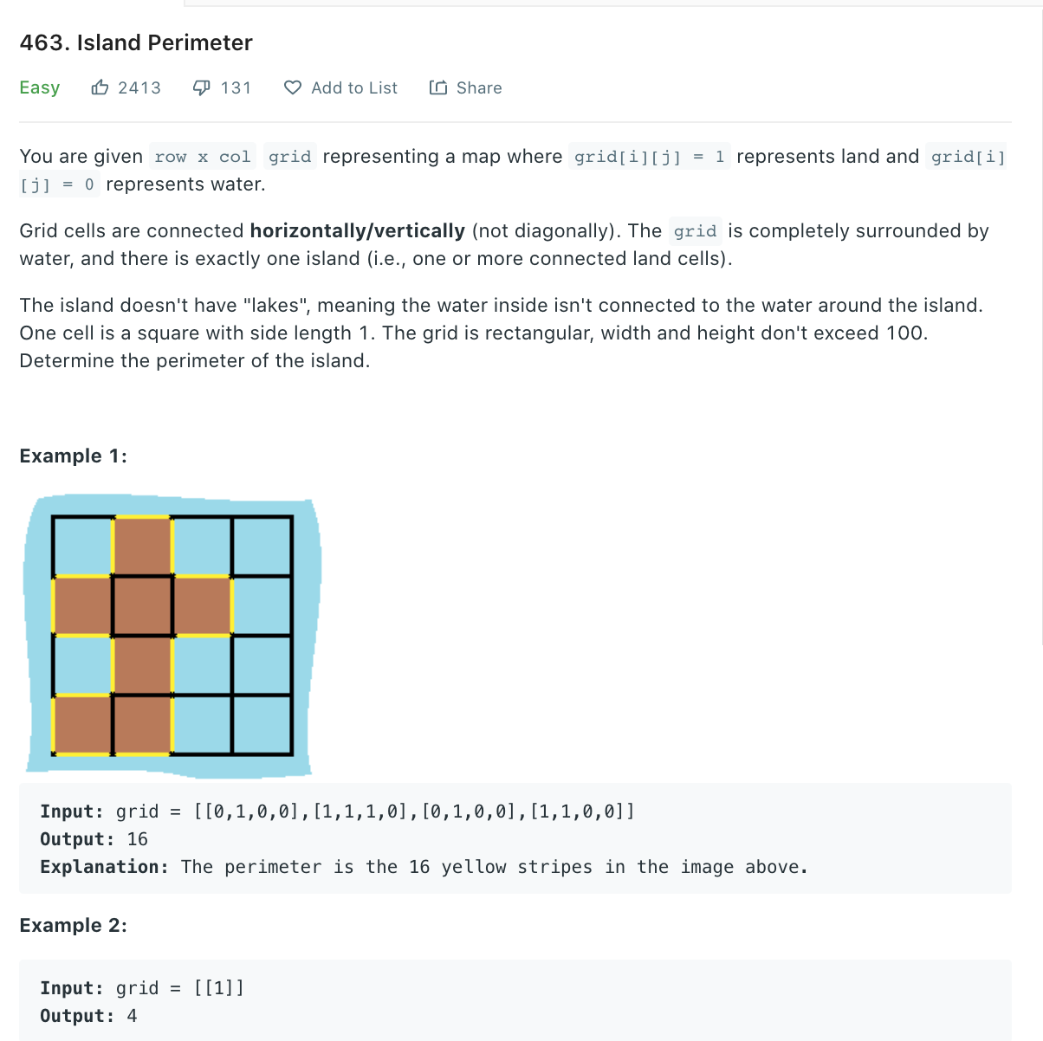
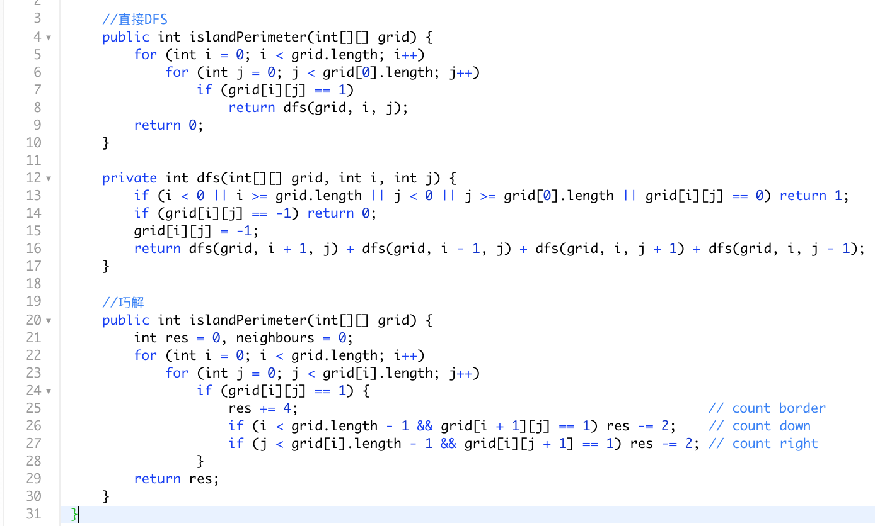
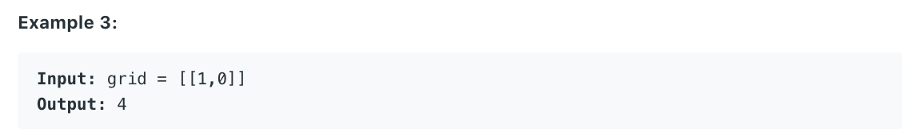
数边界，暴力dfs或者使用巧妙解，每个单独快可以提供4个边界，有相邻的岛屿每一个少提供一个边界

Slide 7
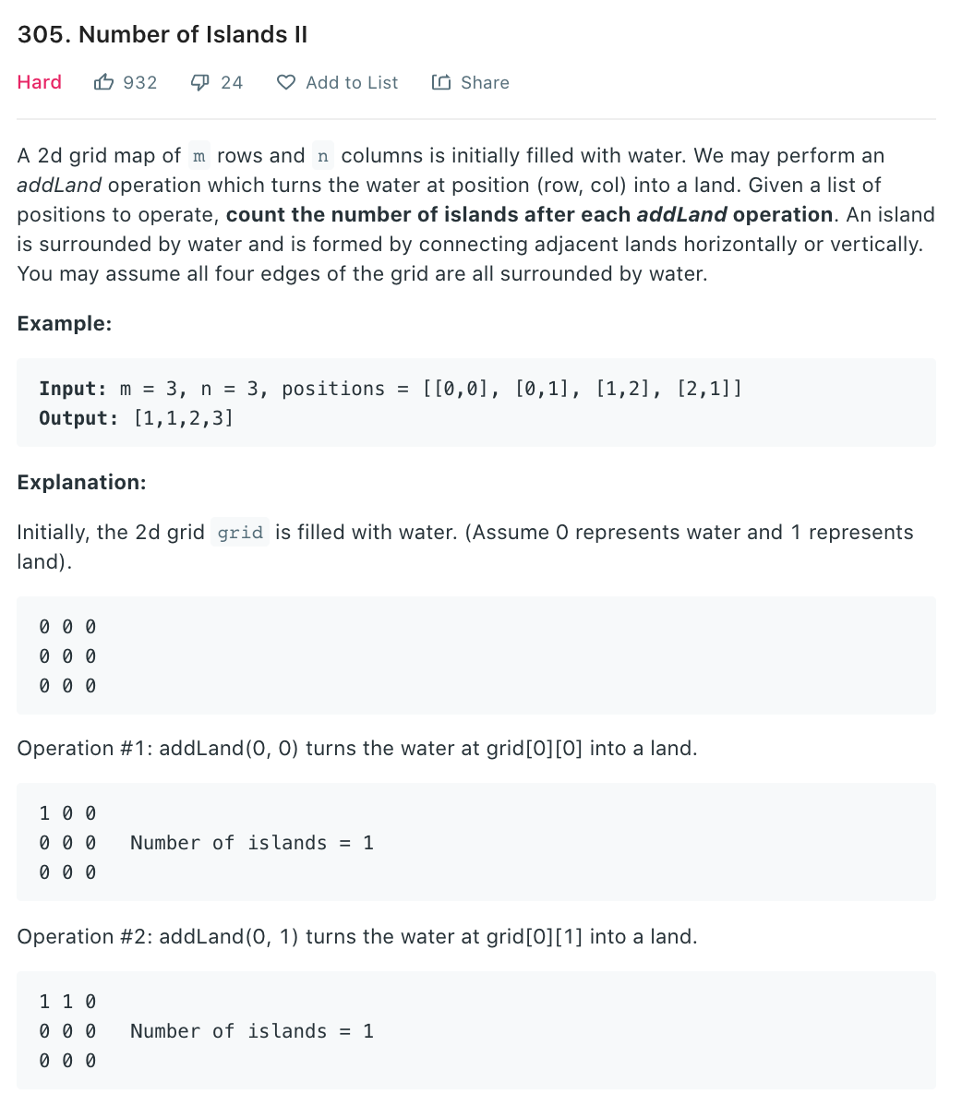
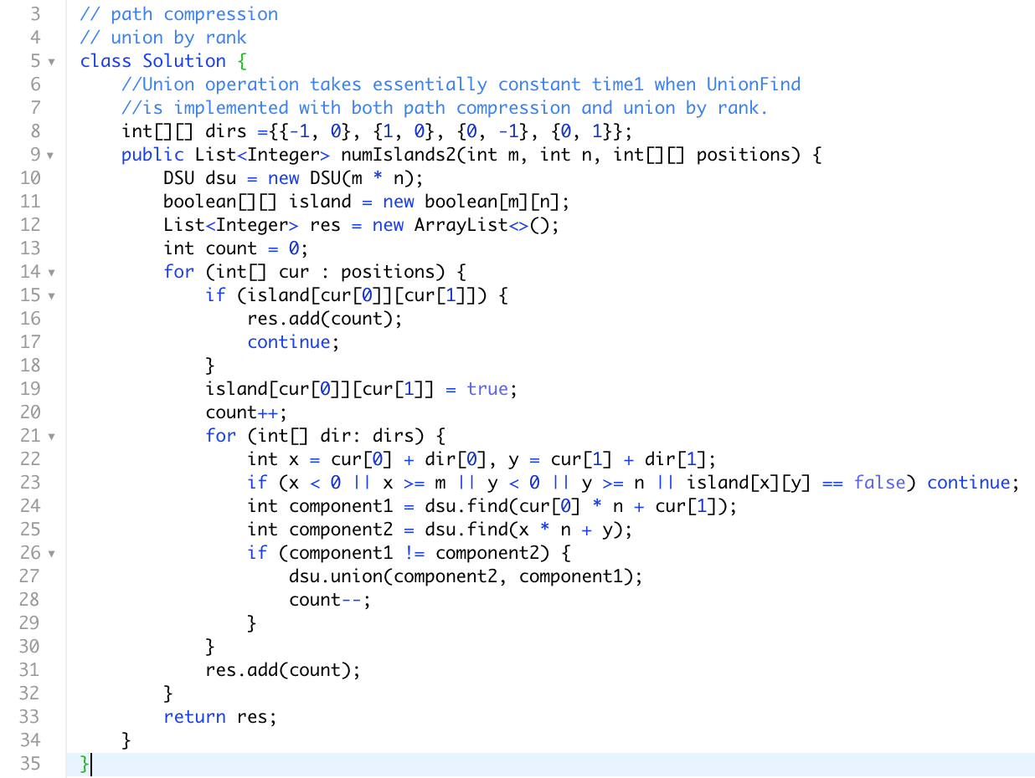

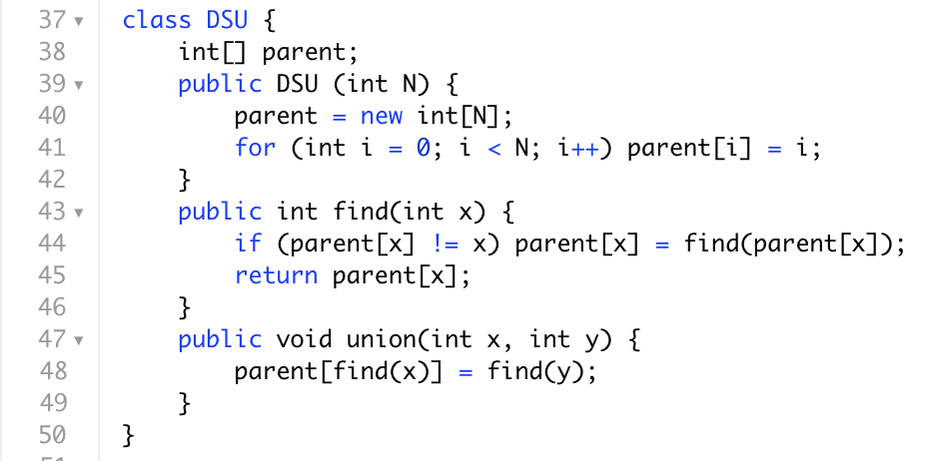
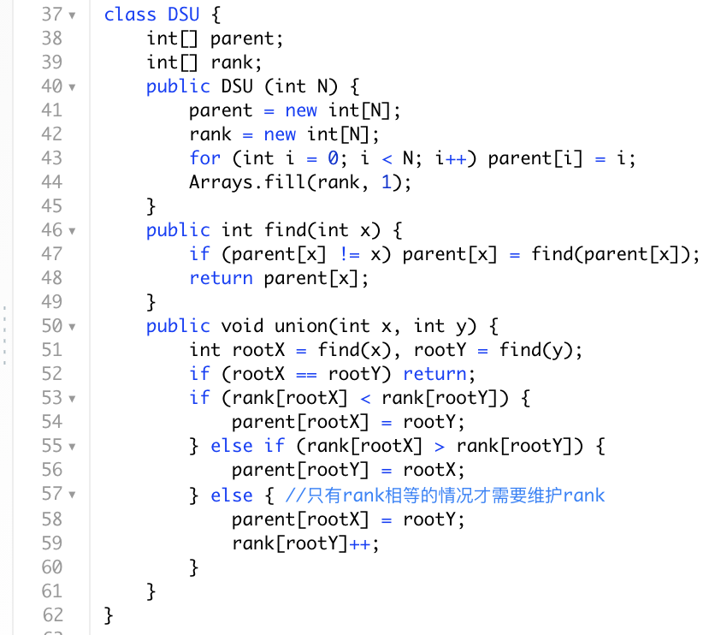
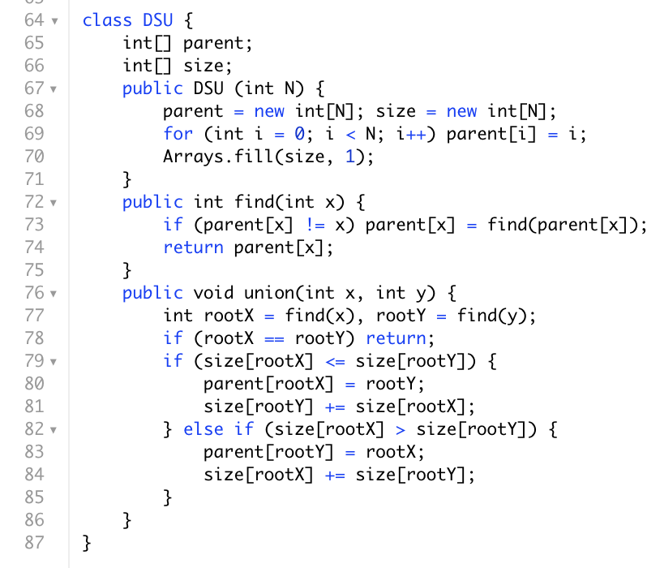
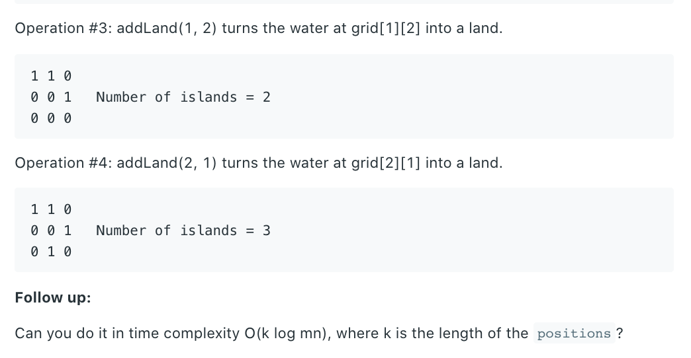
基础模板
UF模板题，找过程中group size
优化by rank, by size模板
Time complexity
O(mn + k)
m*n 是第43行初始化DSU
k是operations数量

Slide 8
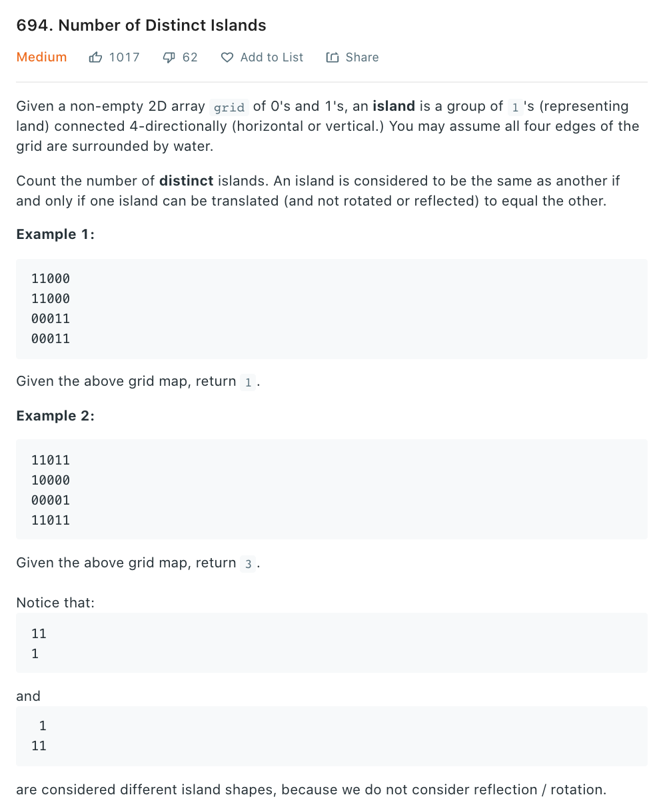
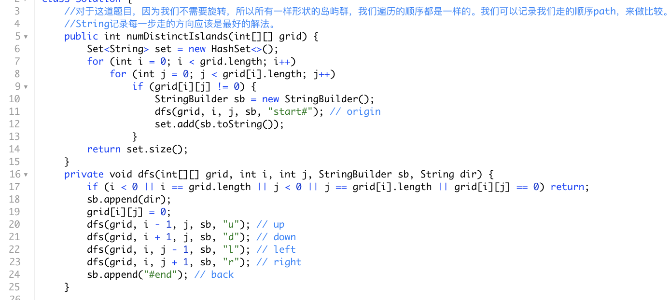
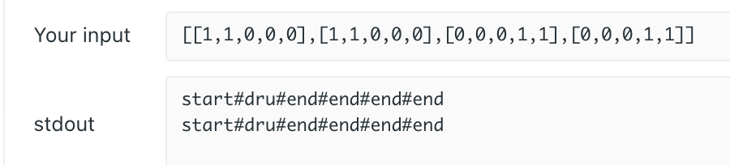
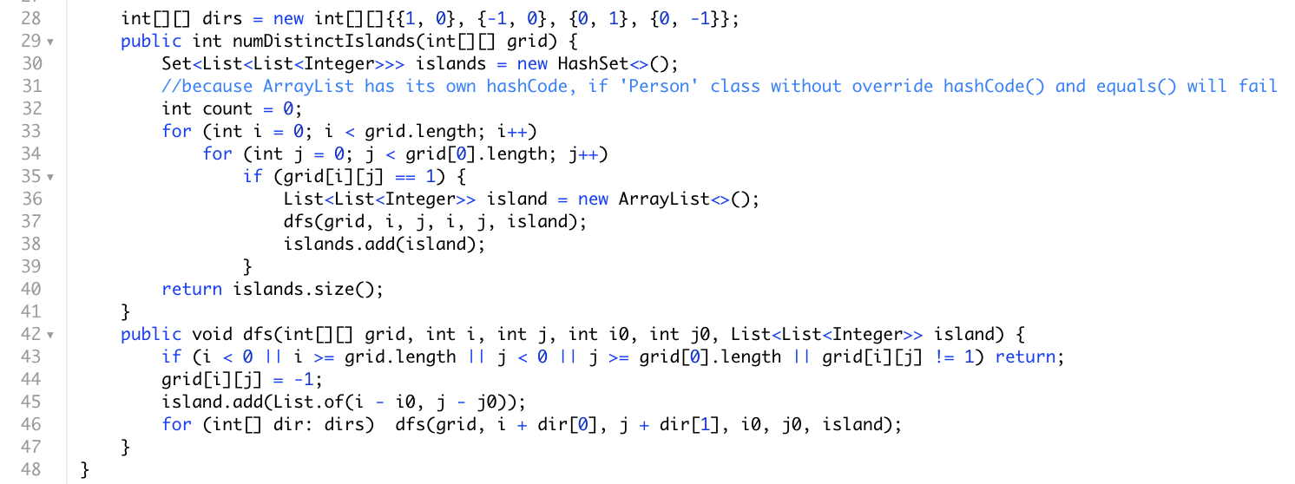
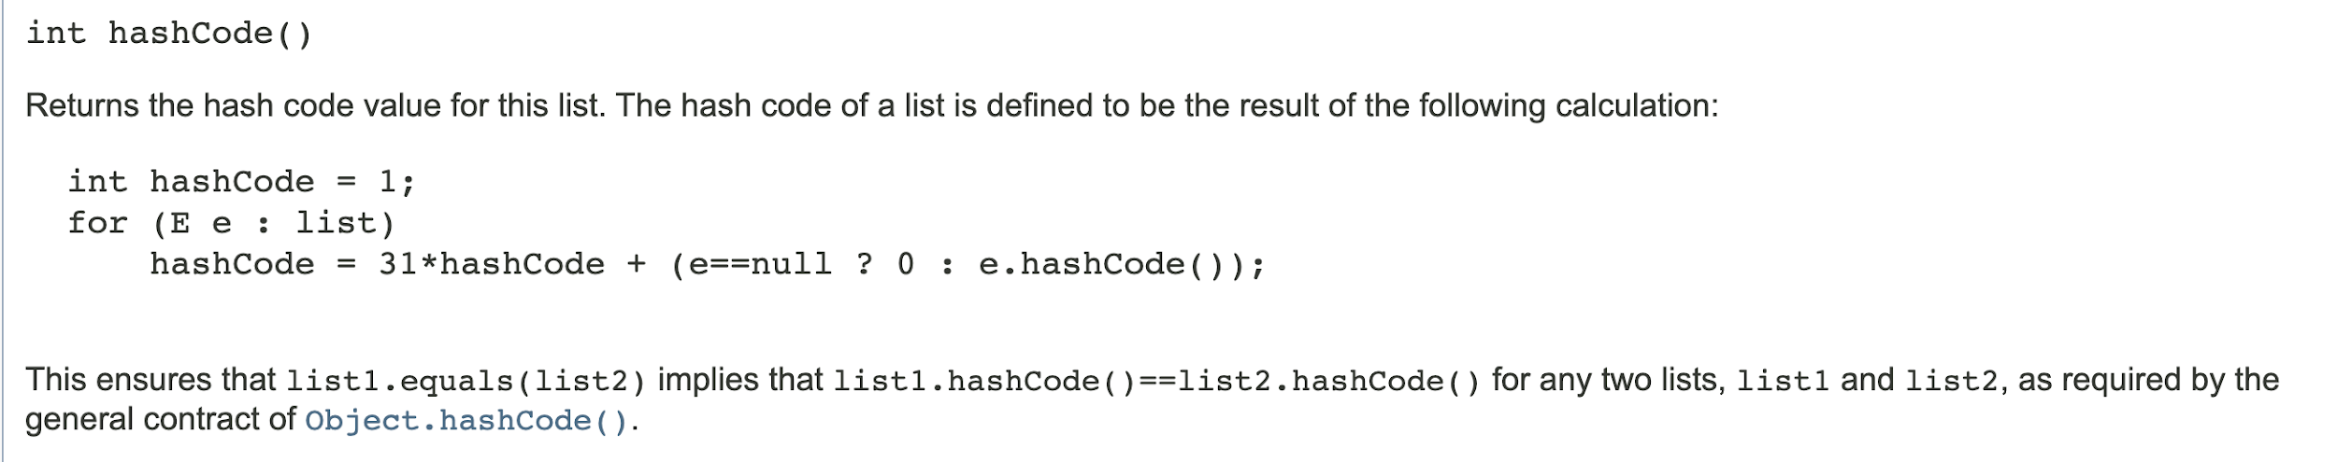
记录遍历路径来描绘形状, 然后找不同形状的有几个
必须用相对位置，因为起点i0, j0已经变化了

Slide 9
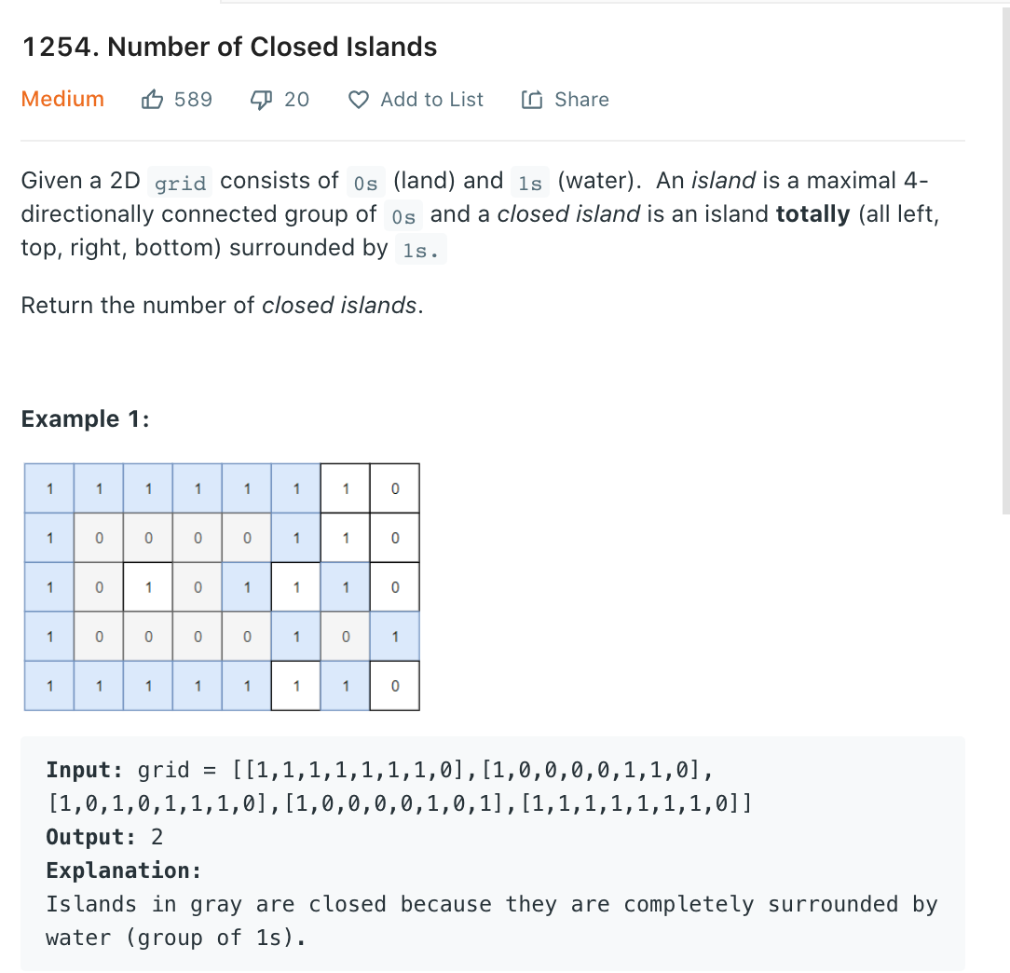
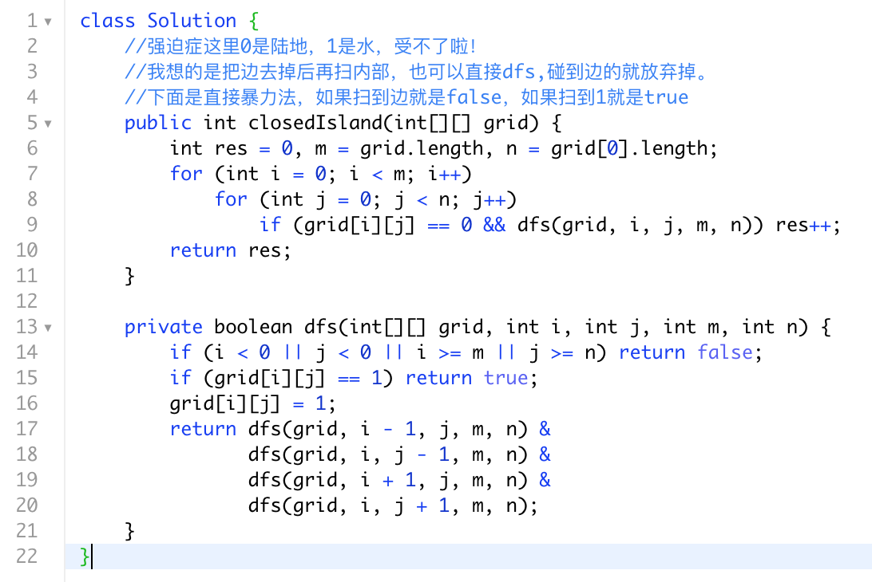

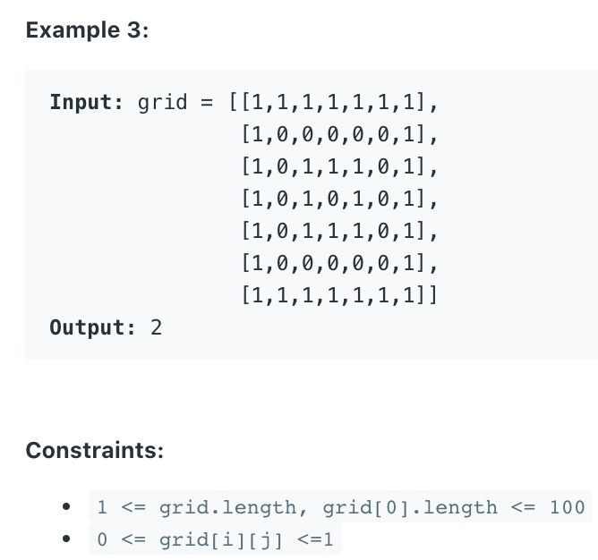
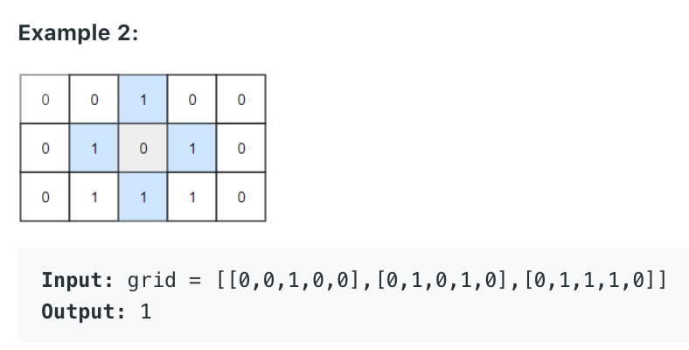
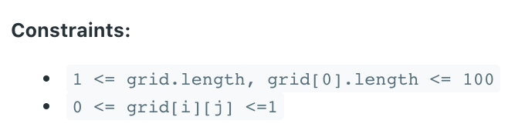
暴力法直接dfs找全包围岛屿，注意这里01含义，找到岛屿四周延伸都是被水包围的点
0,1定义不一致，强迫症很难 受

Slide 10
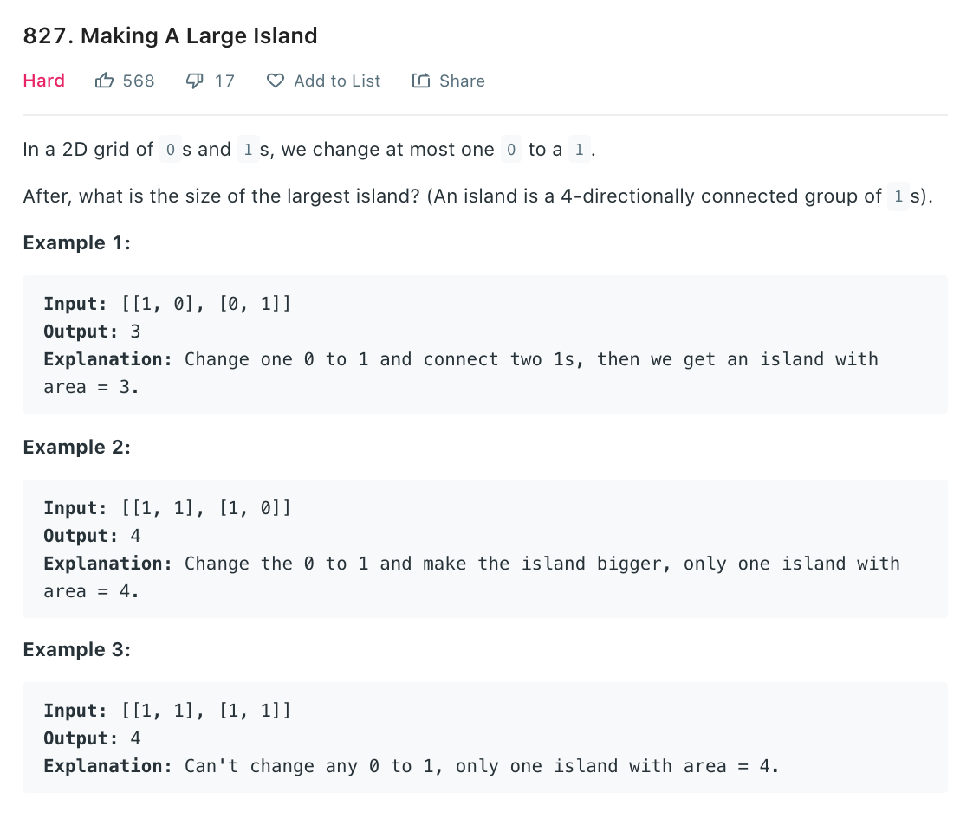
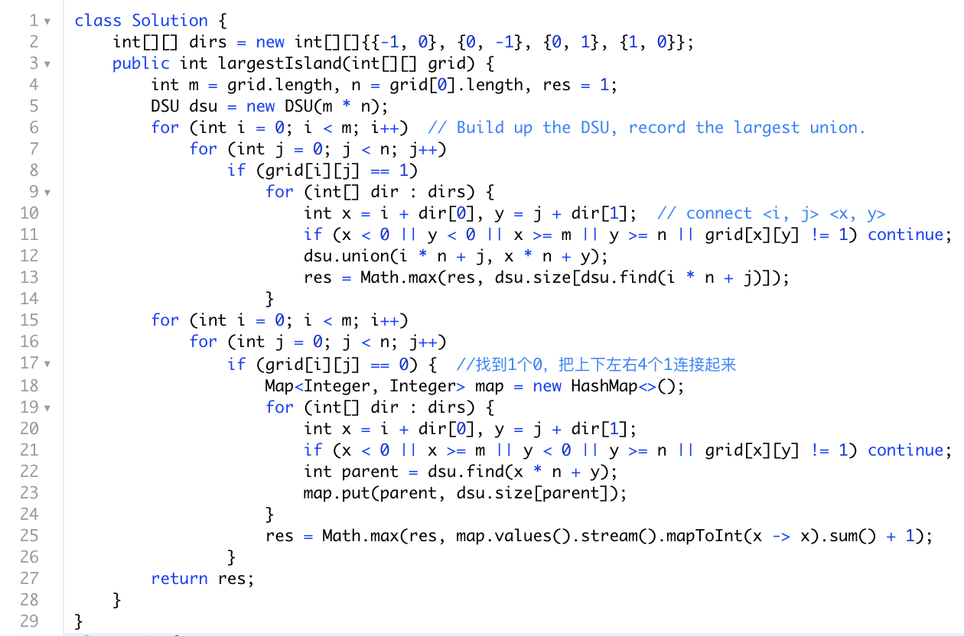
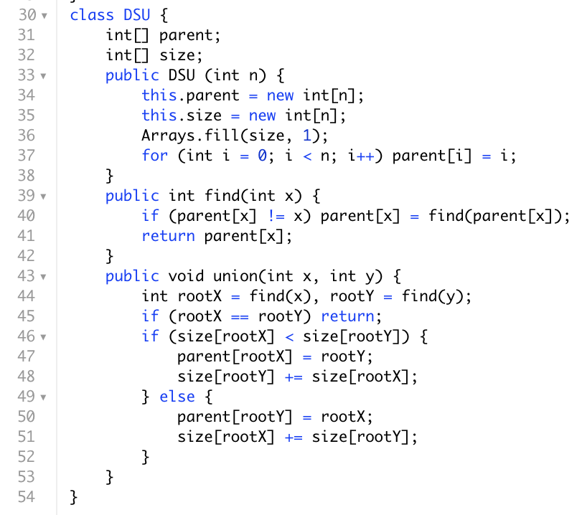
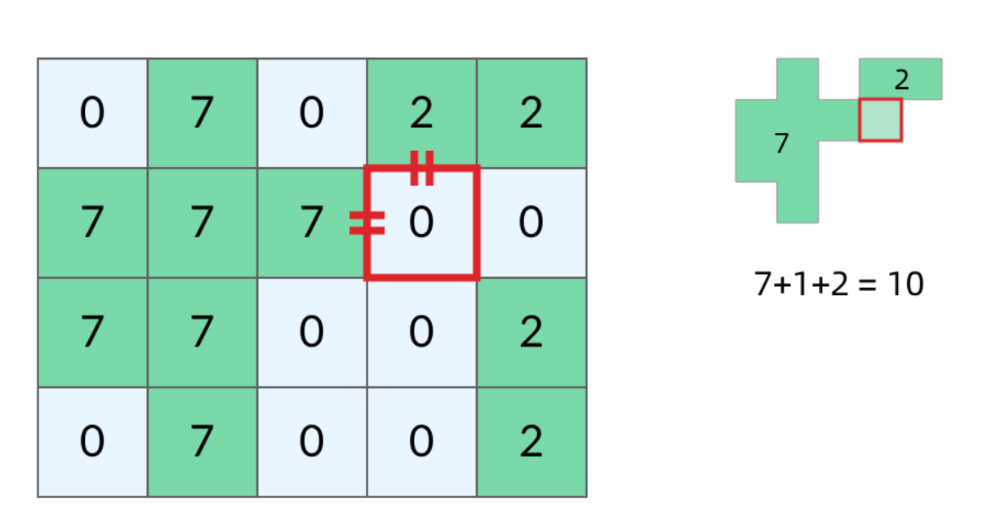
套娃题，直接算出每一个island的面积，然后暴力把所有可以连接的点都算一遍，因为我们只能翻一个牌子
T(n) = O(mn) m,n is the length of matrix

Slide 11
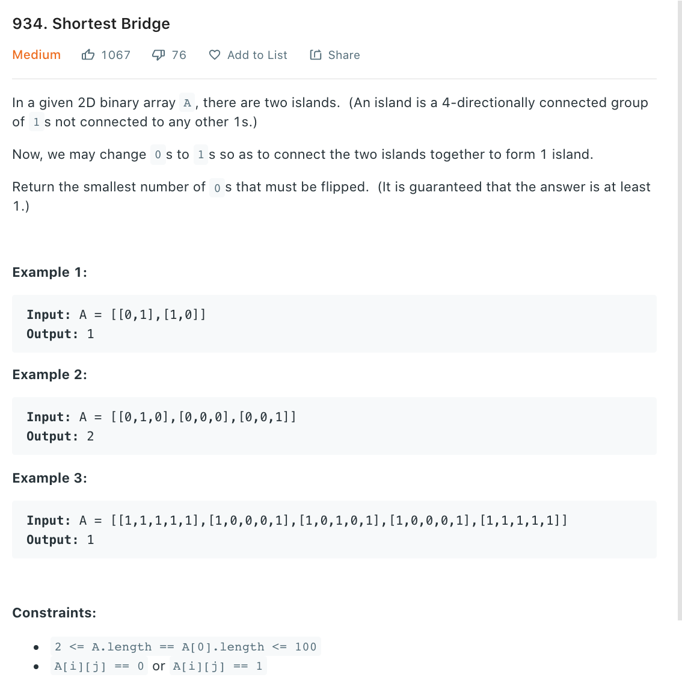
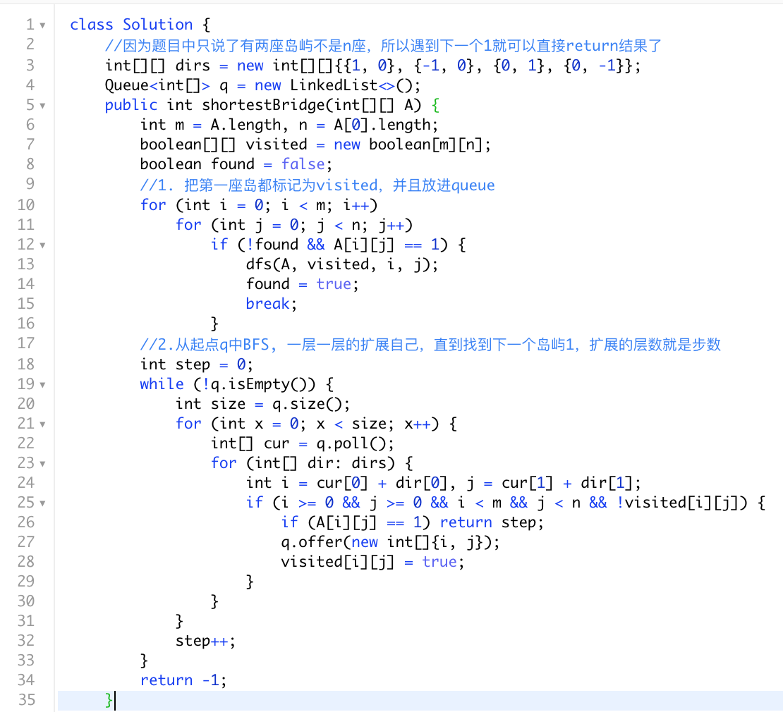
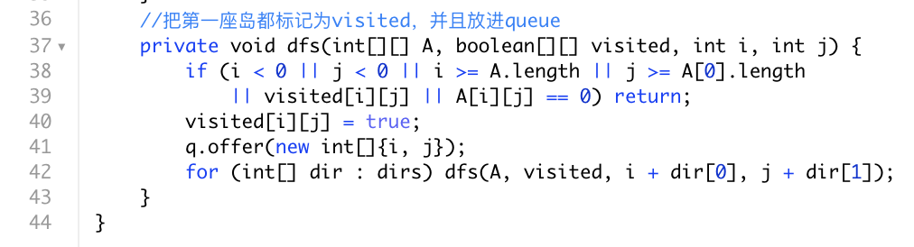
我们现在可以翻多个牌子，两座岛屿找最短距离，应该可以双向BFS优化，双向BFS请见例题的PPT

Slide 12
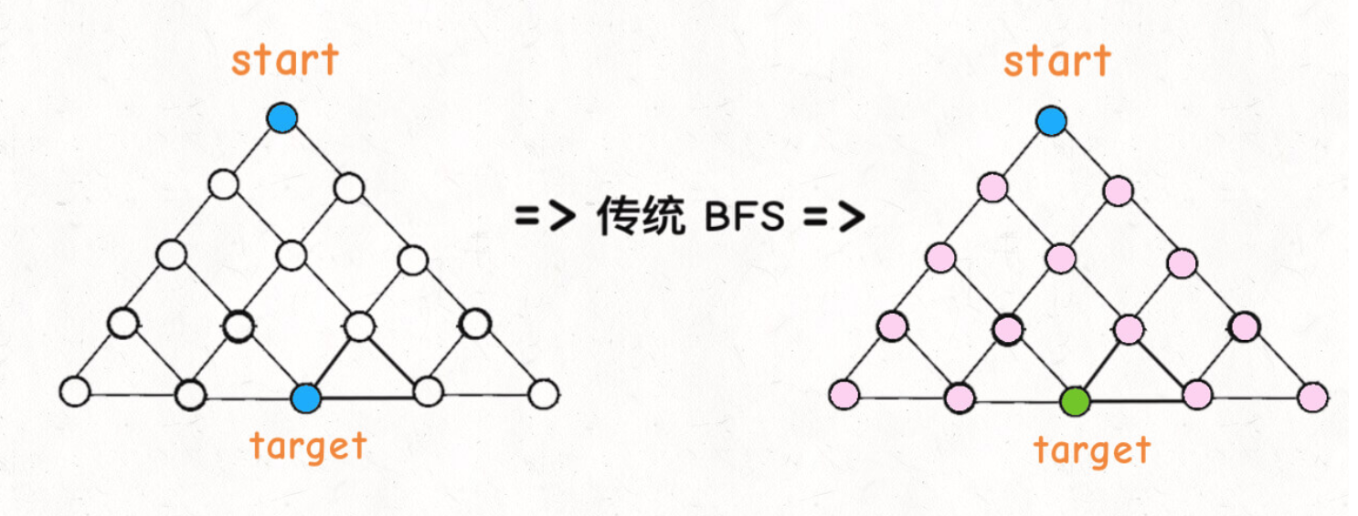
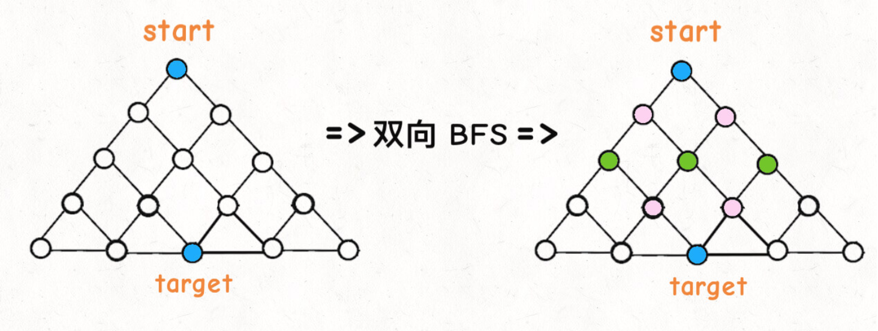
优化？双向BFS
传统的 BFS 框架就是从起点开始向四周扩散，遇到终点时停止；而双向 BFS 则是从起点和终点同时开始扩散，当两边有交集的时候停止。
图片来自: labuladong

Slide 13
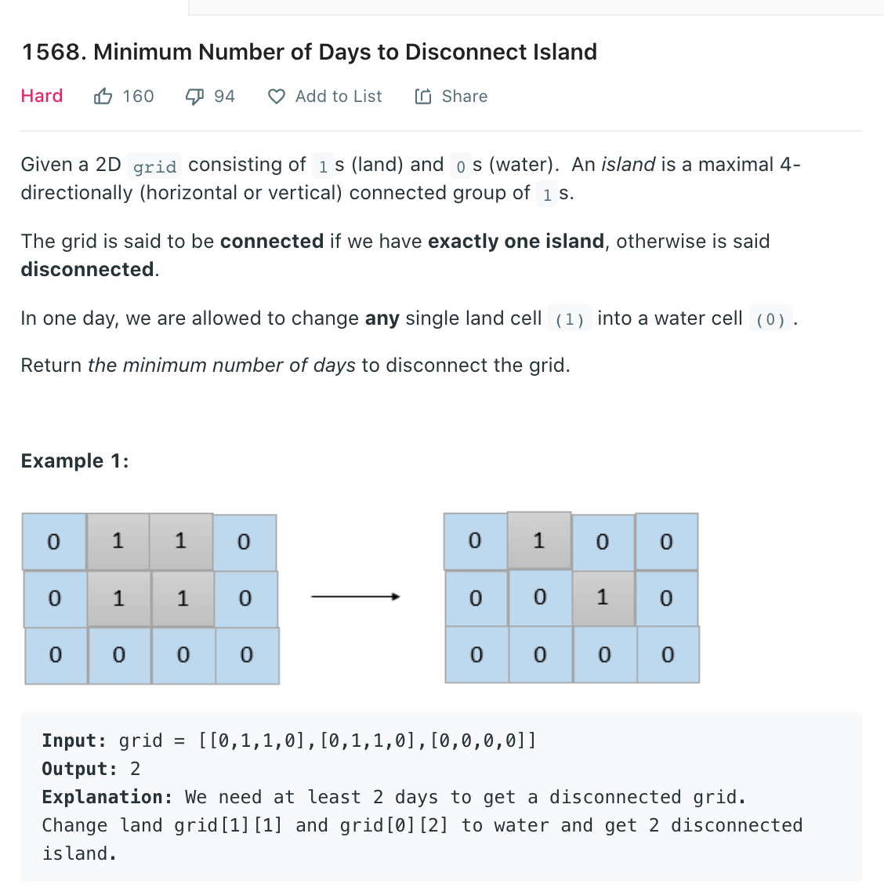
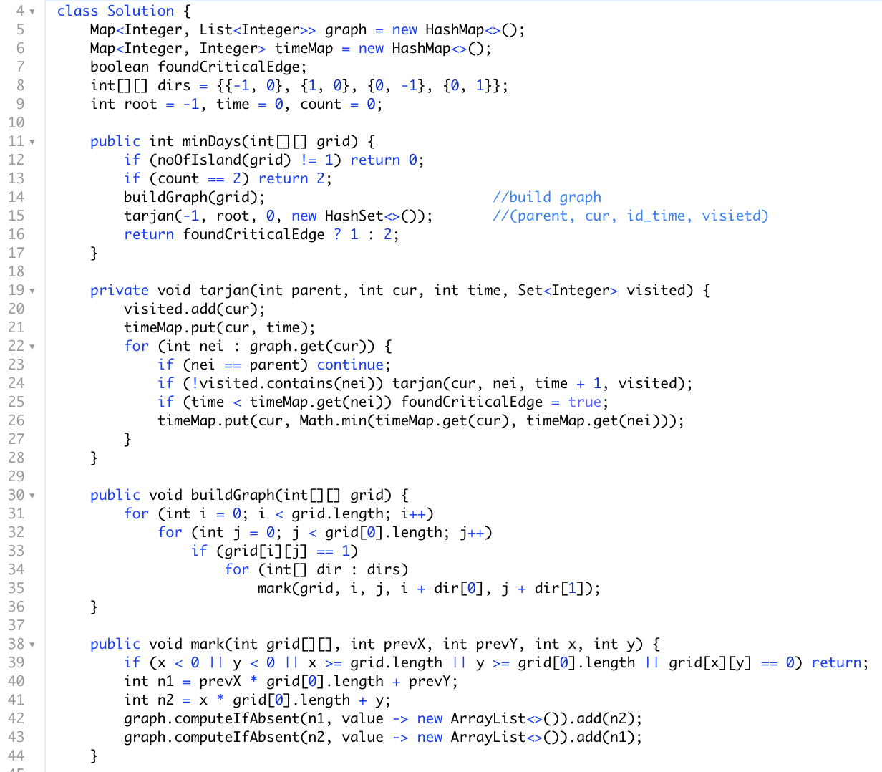
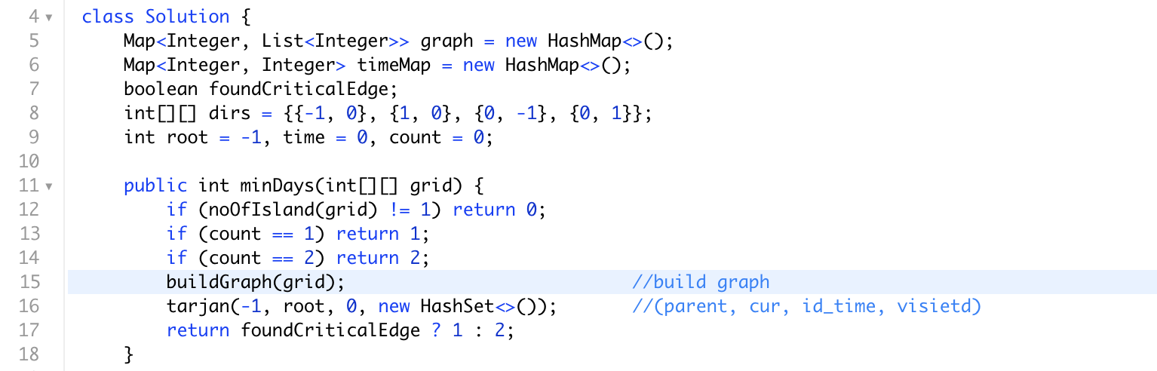
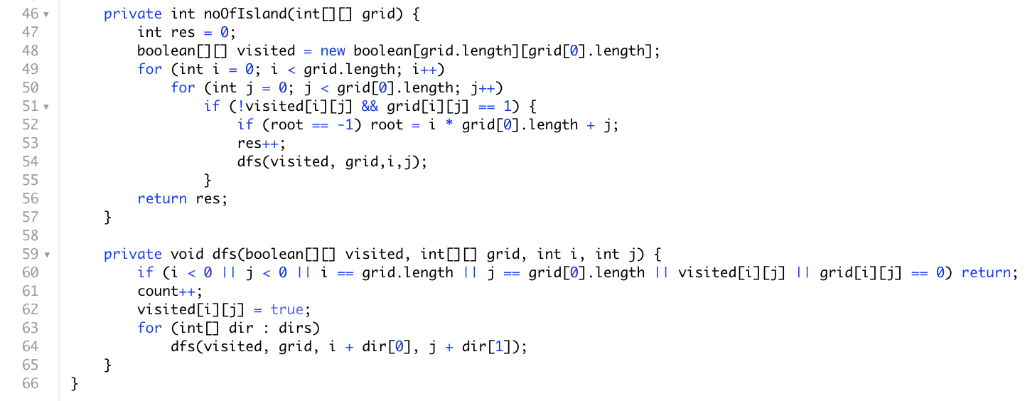
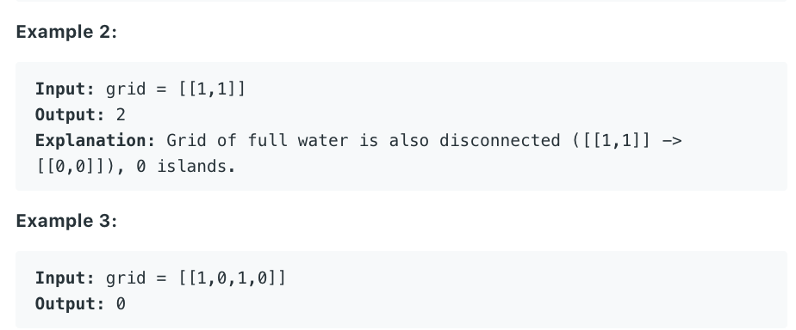
Tarjan’s algorithm来找critical edge, 因为只能切0，1或2刀
Tarjan 详解见图PPT第四节

Slide 14
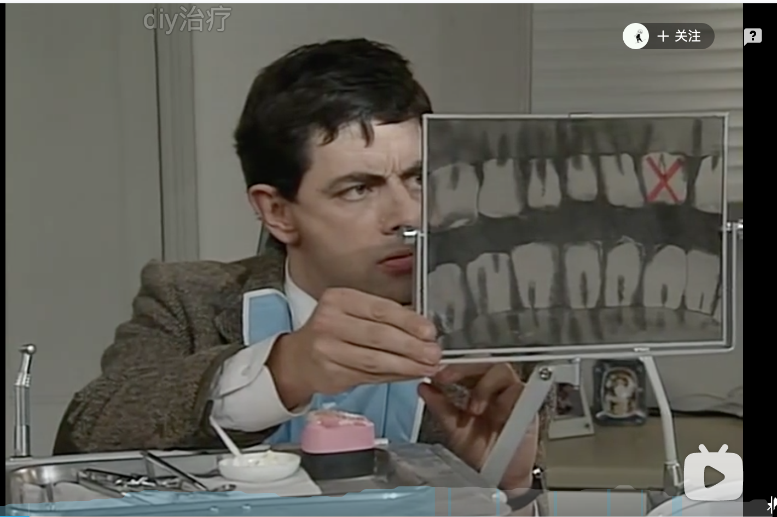
憨豆先生看牙医
https://www.bilibili.com/video/BV1cE411k7na?p=6

Slide 15
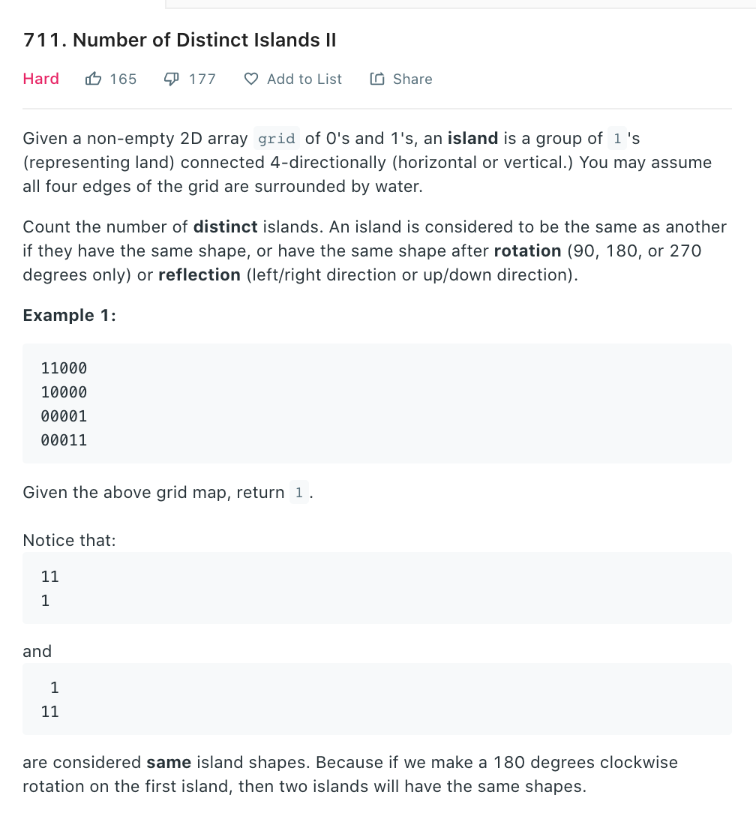
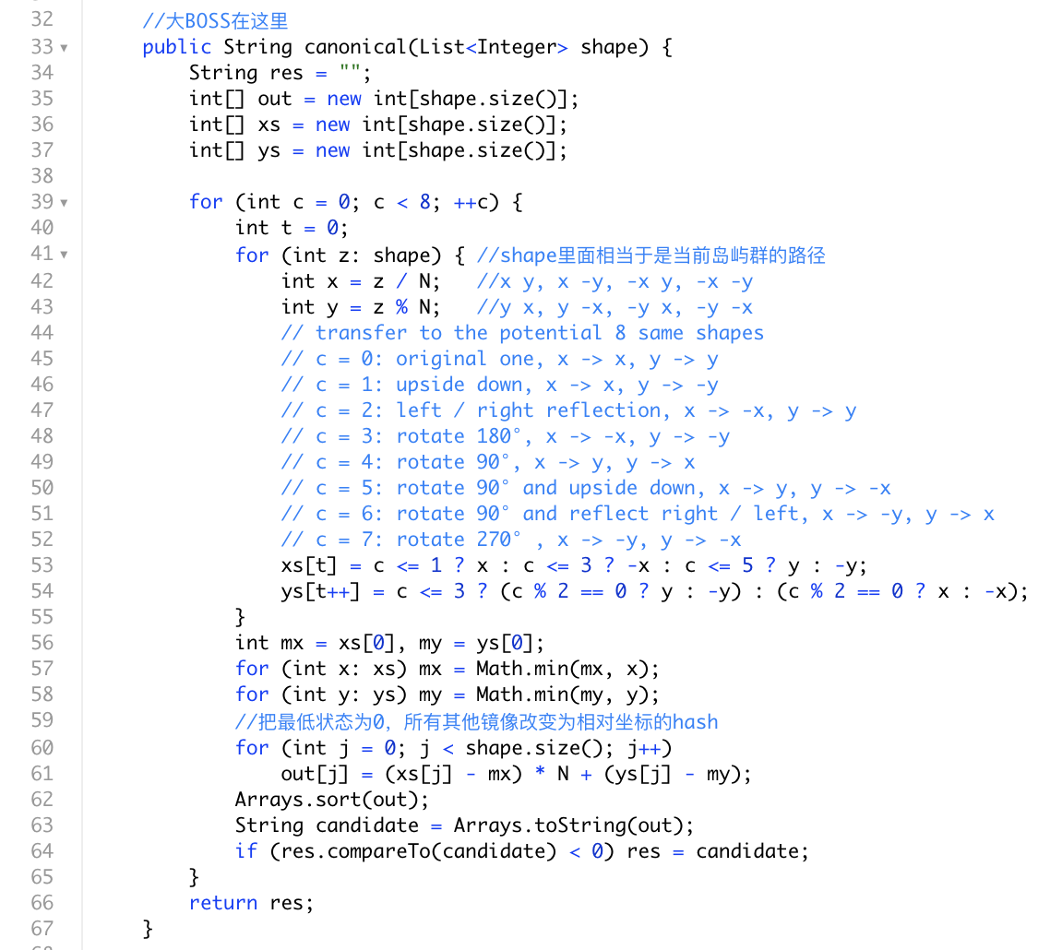
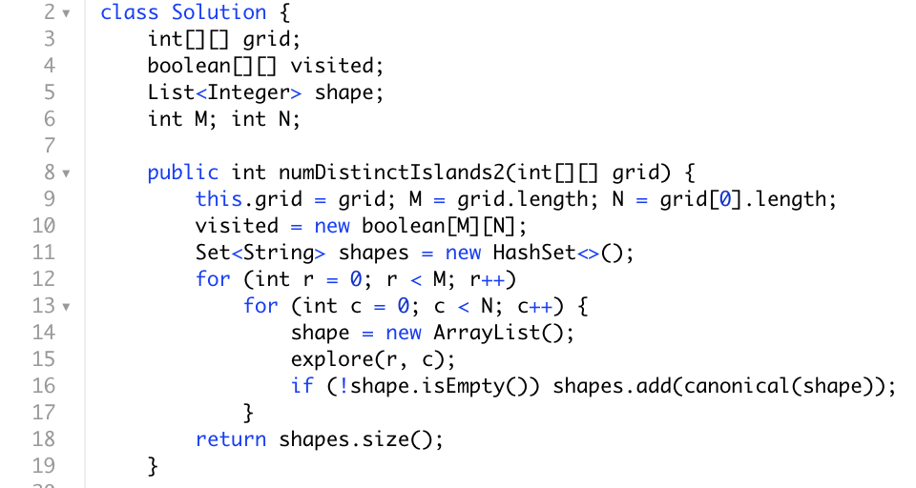
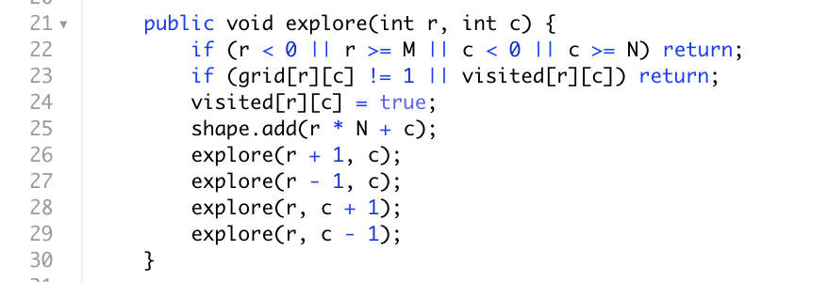
canonical (hash) 翻译成中文是经典的，最简介的，或者说最自然的，稳定的

Slide 16
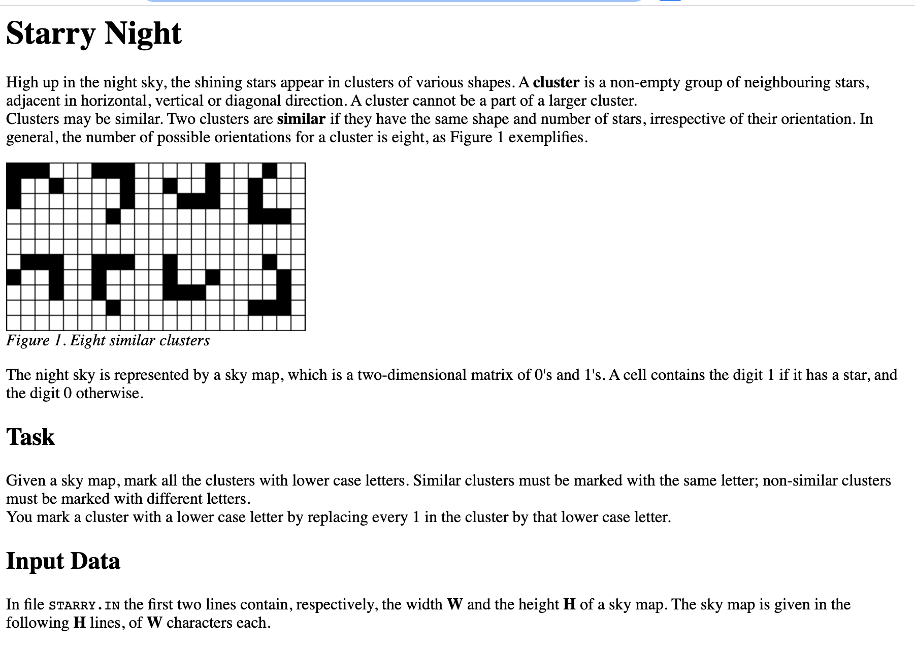
来自国际信息奥林匹克竞赛
http://olympiads.win.tue.nl/ioi/ioi98/contest/day1/starry/starry.html

Slide 17
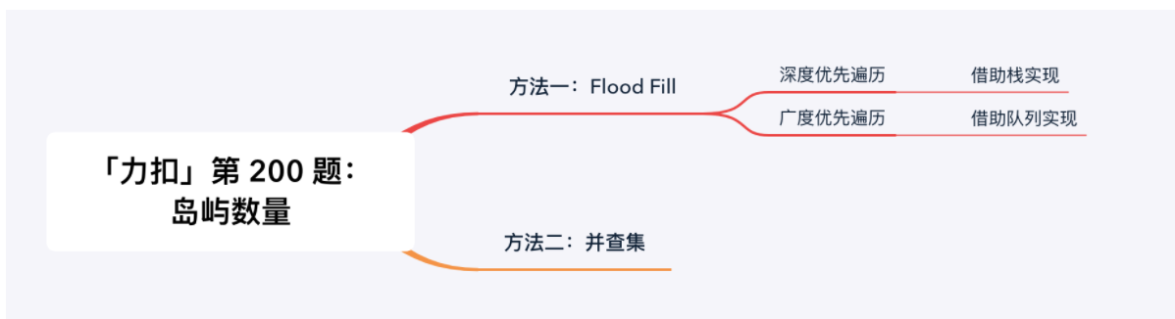
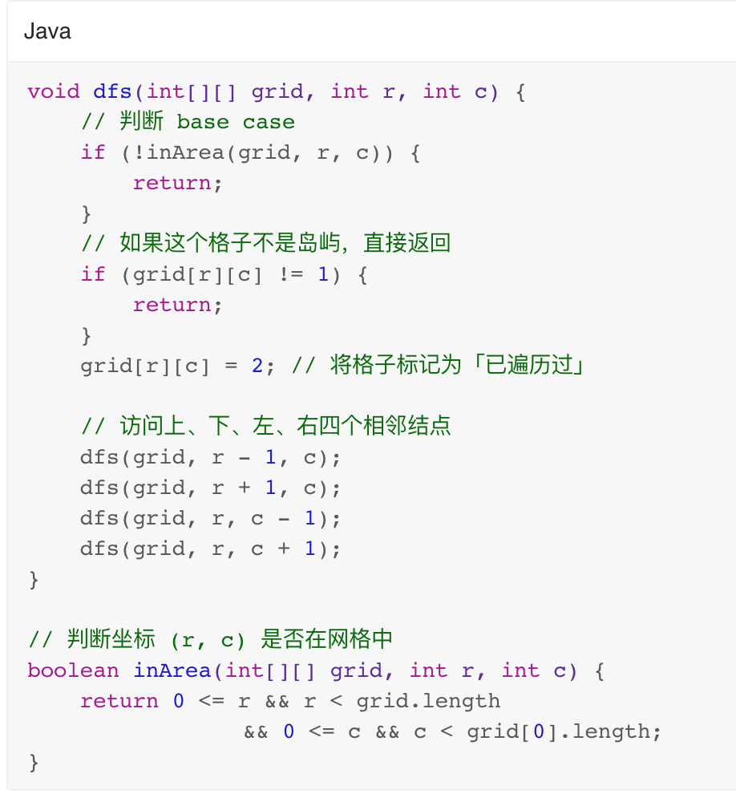
Summary
DFS和BFS必须熟悉，stack和queue
Union Find 必须熟练，默认模板外加2种优化
Trajan’s只有亚麻考察过，考到的概率极低
shape1可以用路径辨别，shape2建议只讲讲思路，出竞赛题这是想让你挂

Slide 18
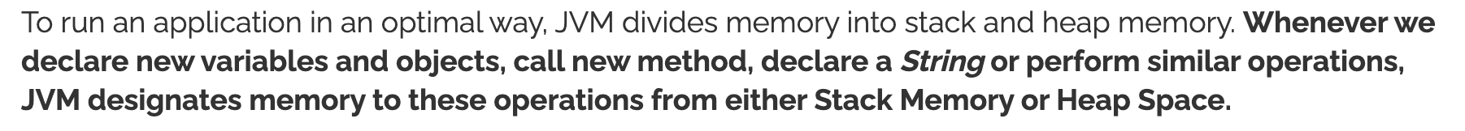

附录: Stack Memory and Heap Space in Java
Stack Memory in Java is used for static memory allocation and the execution of a thread. It contains primitive values that are specific to a method and references to objects that are in a heap, referred from the method.
Heap space in Java is used for dynamic memory allocation for Java objects and JRE classes at the runtime. New objects are always created in heap space and the references to this objects are stored in stack memory.

Slide 19



https://www.baeldung.com/java-stack-heap

Slide 20

Default stack size varies between 320k and 1024k depending on the version of Java and the system used. For a 64 bits Java 8 program with minimal stack usage, the maximum number of nested method calls is about 7 000. Generally, we don't need more, excepted in very specific cases. One such case is recursive method calls.
The default maximum heap space is 1/2 of the physical memory of size up to 192 bytes and 1/4th of physical memory for the size up to 1Gig. So for 1Gig machine maximum heap size is 256MB 2.maximum heap size will not be used until the program creates enough object to fill initial heap space which will be much lesser but at-least 8 MB or 1/64th part of Physical memory up to 1GB.

